Slide 1



Vehicle Maintenance System
FRONTEND
Torque Titans

Slide 2


Introduction
Goal:
Develop a system to manage the car maintenance process at a garage – including customer information, vehicles, technicians, and services performed
Key Features:
Manage customer and vehicle information
Track services and progress
User role management (Admin / Technician)
Quick statistics and reporting
Target Users:
Garage Administrator
Maintenance Mechanic

Slide 3


Business Logic
Business Logic
The layer that handles requests and coordinates data between the user interface and the database
Main Features:
User authentication (login, role-based access)
Data management (add, edit, delete, search customers/vehicles/services)
Display & statistics (services, tasks, vehicle details)
Workflow:
Receive request → Process (Controller) → Query (DAO) → Update UI
Core Values:
Accuracy, flexibility, efficiency

Slide 4



Frontend
Login
Admin Dashboard
Mechanic Dashboard

Slide 5
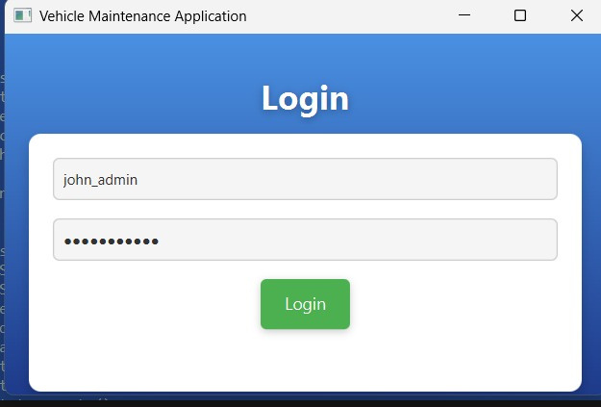
Login Screen
User authentication based on username and password
Redirect users to the appropriate interface based on their role (Admin Dashboard or Mechanic Dashboard)

Slide 6
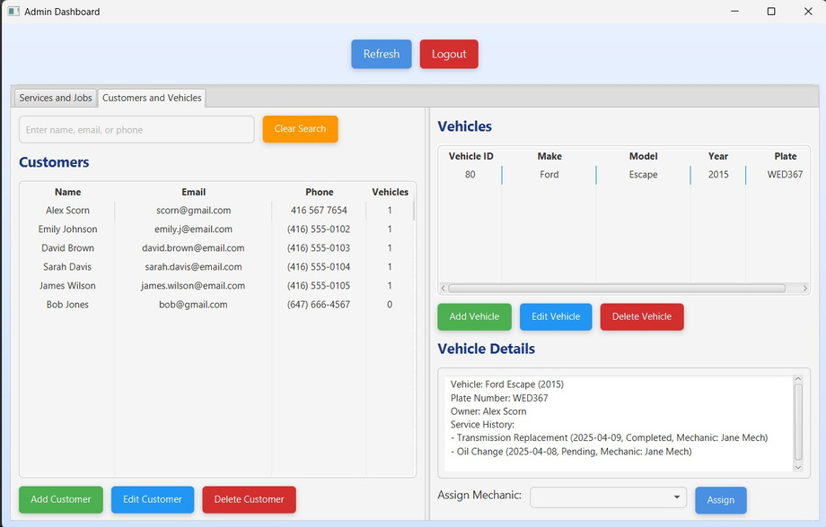
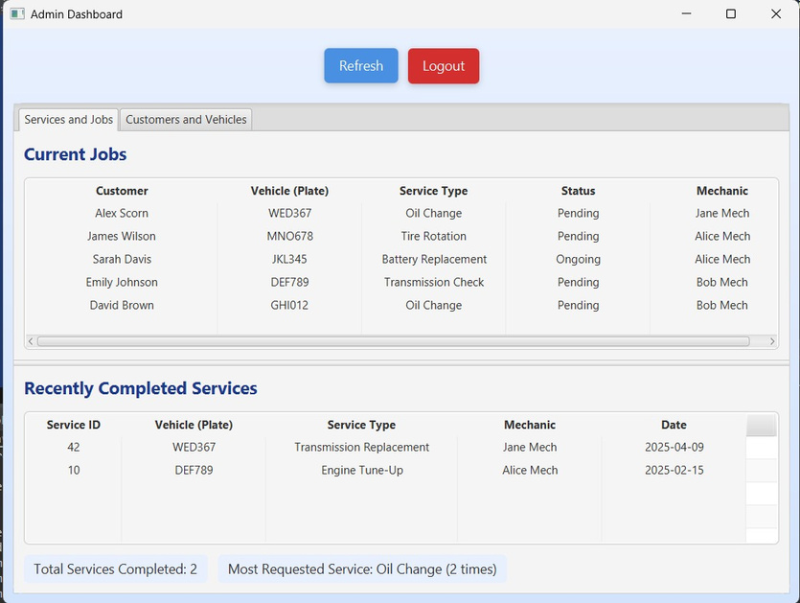
Admin Dashboard
Provides an overview of vehicle maintenance activities
Allows administrators to perform data management operations (add, edit, delete)
Supports mechanic assignment and job status tracking

Slide 7
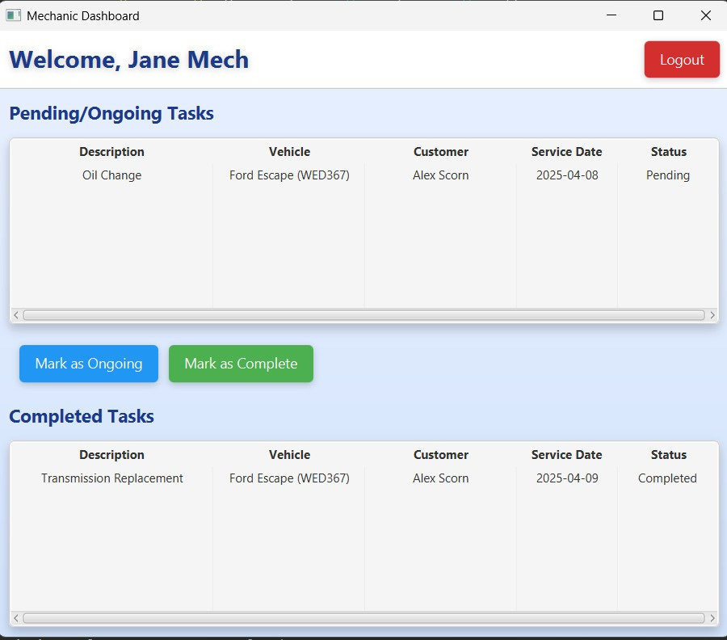
Mechanics Dashboard
Displays a list of assigned maintenance tasks
Allows mechanics to update job status (Pending, Ongoing)
Provides detailed information about the vehicle related to the task

Slide 8
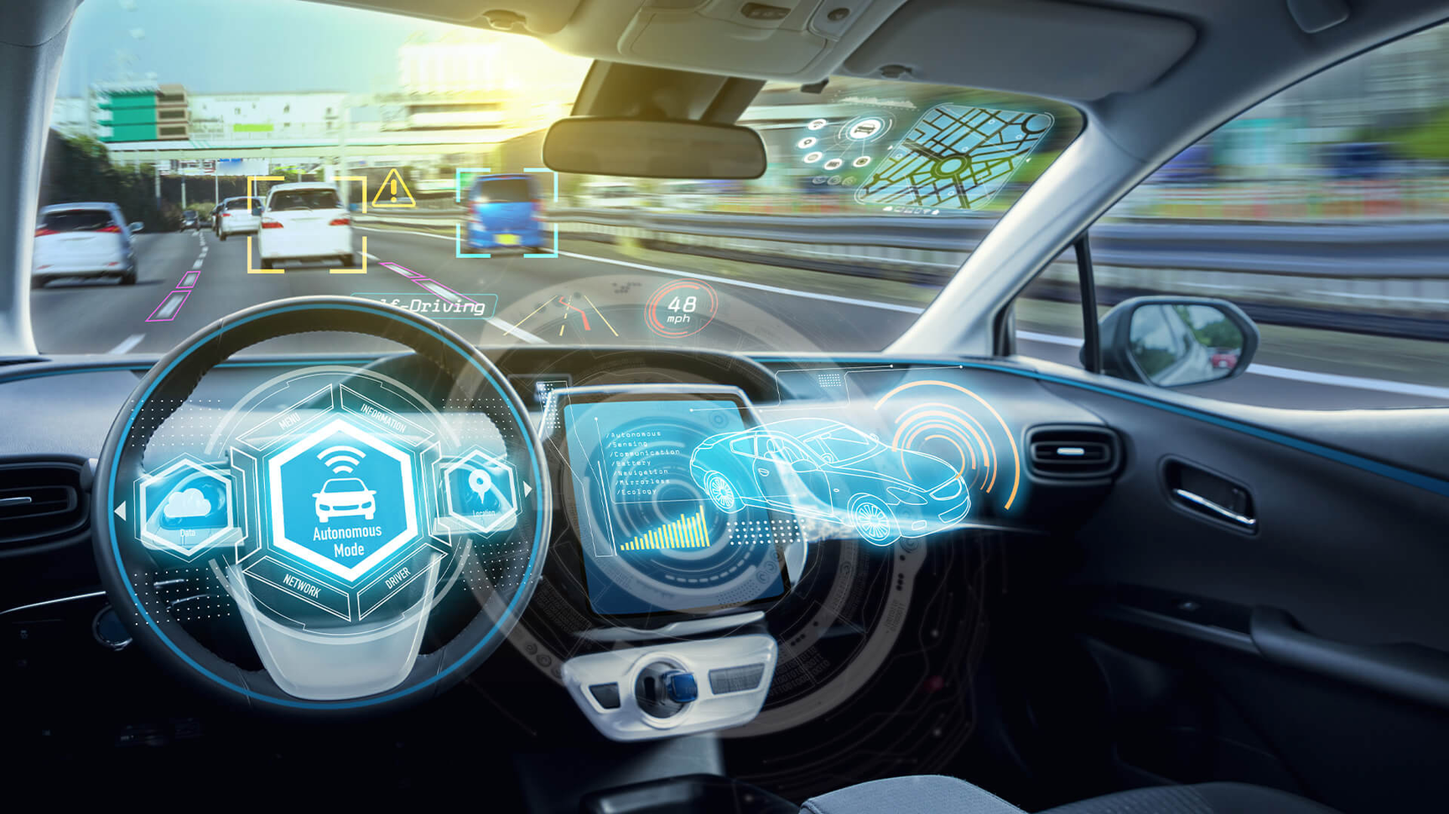
THE CHALLENGES
OF PROJECT
Create role-specific interfaces: Designing the Admin Dashboard with multiple complex tabs, while the Mechanic Dashboard needs to be simple, displaying only assigned tasks
Real-time data updates: Ensuring TableView (e.g., customersTable, tasksTable) automatically refreshes when the Admin adds/removes customers or the Mechanic updates task status
Complex user event management: Handling multiple simultaneous interactions, such as selecting a customer to view their vehicle, selecting a vehicle for details, or searching in the Admin Dashboard

Slide 9

Future Plan
Expand the functionality of component inventory management.
Add revenue reports and technician performance statistics.
Help track the inventory quantity of components, including inbound and outbound transactions, and assign them to specific repair vehicles.
Support the management team in tracking monthly activities, revenue, and the number of vehicles repaired.
Support multiple languages."
Optimize the interface for mobile devices.
Make the system more user-friendly for users in different regions (e.g., English and Vietnamese).
Responsive UI to allow technicians or admins to easily operate on mobile phones.

Slide 10



Thank You
For your attention! If you have any questions or would like to discuss further, please feel free to reach out.

